Slide 1

Algorithm Analysis
CS 2321
Data Structures and Algorithms
Dr. Mahmoud Hassaballah

Slide 2
Outlines
Introduction
Mathematics Background
Model
What to Analyze?
Running Time Calculations
A Simple Example
General Rules
Solutions for the Maximum Subsequence Sum Problem
Logarithms in the Running Time

Slide 3
1. Introduction

Slide 4
Objectives
We shall discuss:
How to estimate the time required for a program.
How to reduce the running time of a program from days or years to fractions of a second.
The results of careless use of recursion.

Slide 5
Introduction
An Algorithm is a clearly specified ordered set of simple instructions (input - output - computation – decision - repetition) to be followed to solve a problem.
Describe: in natural language / pseudocode / diagrams / etc.
Criteria:
Input: Zero or more quantities (externally produced).
Output: One or more quantities .
Definiteness: Clarity, precision of each instruction.
Finiteness: The algorithm has to stop after a finite (may be very large) number of steps.
Effectiveness: Each instruction has to be basic enough and feasible.

Slide 6
Introduction
Implementation
Decide on the programming language to use
Write clean, well documented code
Correctness: An algorithm is said to be correct if for every input instance, it halts with the correct output.
Performance or Efficiency or Complexity: Computing time and memory space are two important resources (we deal with estimates).
The computational complexity and efficient implementation of the algorithm are important in computing, and this depends on suitable data structures.

Slide 7
Introduction
Algorithm performance usually computed either by:
Empirical Method; or
Analytical Method.
To compare two algorithms using empirical method, we need to convert each to a program using the same programming language. After that we run both programs and see which one runs faster.
In analytical method, each algorithm is mapped to a function. Then the functions are compared in terms of their growth rate to decide which is better.

Slide 8
Introduction
Why Empirical Method is not Feasible?
That’s because when running a program on a computer there are some factors that affect the speed of running such as:
CPU speed.
RAM size.
Hard Disk Drive (HDD).
Graphics Card.
Operating System (OS).
Compiler.
Environment (Backup, Antivirus, …etc).

Slide 9
2. Mathematics Background
Reading: Textbook (Weiss) 2.1

Slide 10
Mathematics Background
The growth rate:
Which is the smaller f(N) = 1000N or g(N) = N²?
For small values of N, we see that f(N) is greater than g(N).
But g(N) grows at faster rate.
Thus g(N) will eventually be the larger function.
The turning point is N = 1000 in this case.

Slide 11
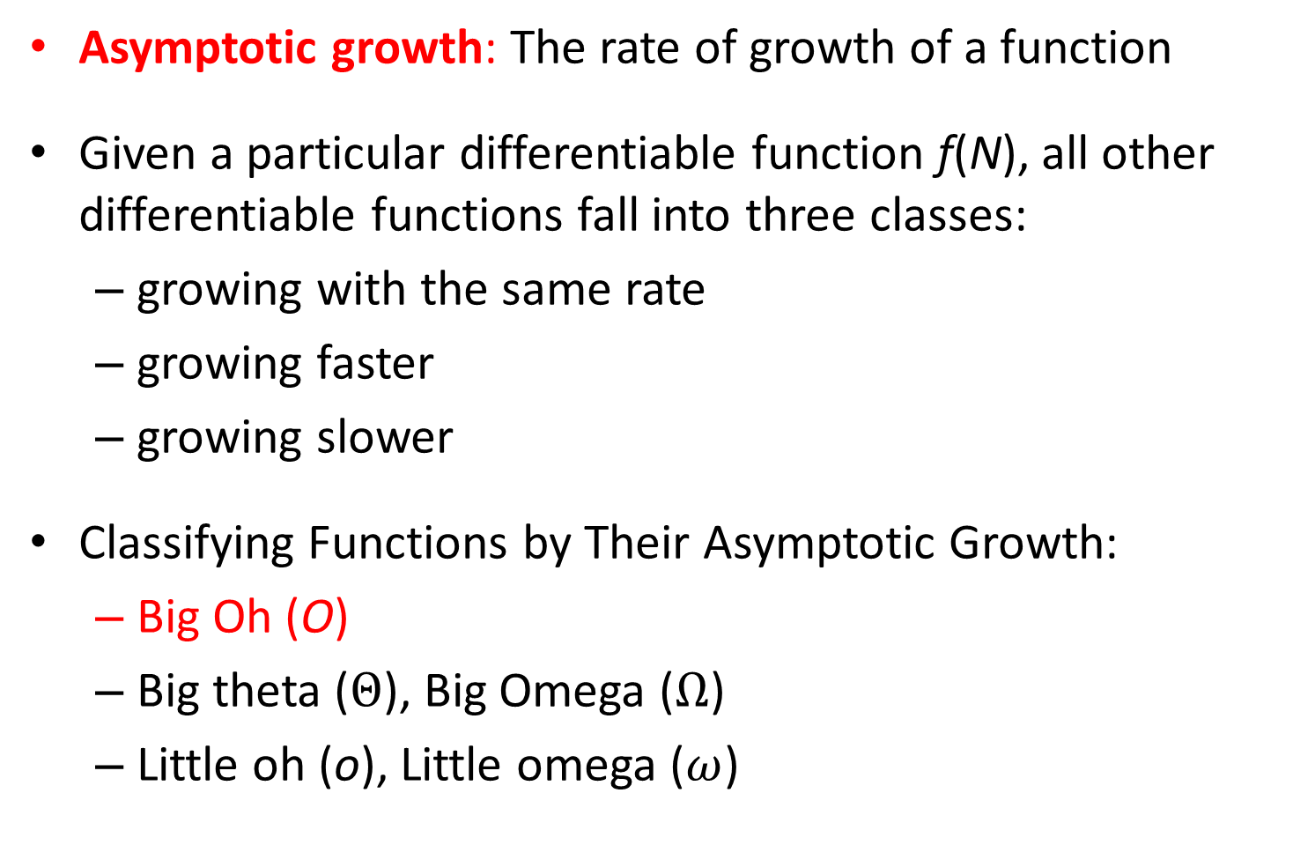
Mathematics Background
Asymptotic growth: The rate of growth of a function
Given a particular differentiable function f(N), all other differentiable functions fall into three classes:
growing with the same rate
growing faster
growing slower
Classifying Functions by Their Asymptotic Growth:
Big Oh (O)
Big theta ($Θ$), Big Omega ($Ω$)
Little oh (o), Little omega ($ω$)

Slide 12
Mathematics Background
The “Big-Oh” Notation:
T(N) = O( f(N)) if there are positive constants c and n₀ such that
T(N) ≤ c f(N) when N ≥ n₀
We read T(N) = O(f(N)) as f(N) is big-Oh of T(N)
The big-Oh notation gives an upper bound on the growth rate of a function.
The statement “T(N) is O(f(N))” means that the growth rate of T(N) is no more than the growth rate of f(N).

Slide 13
Mathematics Background
Example:
(a) 6N + 5 = O(N)
(b) (N ² + 8)(N + 1) = O(N³)
(c) 1 + 2 + … + N = O(N²)
Proof
(a) Observing that 6N + 5 ≤ 7N for N ≥ 5, we have
6N + 5 = O(N) where c = 7 and n₀ = 5.
(b) In this case we see that, for N ≥ 3,
(N² + 8)(N + 1) ≤ (N² + N)(2N) = 2N³ + 2N²
≤ 2N³ + N³ = 3N³
Hence (N² + 8)(N + 1) = O(N³) where c = 3 and n₀ = 3.
(c) Simply notice that 1+ 2 + … + N ≤ N + N + … + N
(N times) for all 1 ≤ N. So we quickly have
1 + 2 + … + N = O(N²) where c = 1 and n₀ = 1.

Slide 14
Mathematics Background
Rules:
For example:
If T₁(N) = O(N²) and T₂(N) = O(N) then
(a) T₁(N) + T₂(N) = O(N²)
(b) T₁(N) * T₂(N) = O(N³)
Do not say T(N) = O(2N²) or T(N) = O(N² + N). The correct form is T(N) = O(N²).

Slide 15
Mathematics Background
Typical Growth Rates
The functions are arranged by the most of growth rate

Slide 16
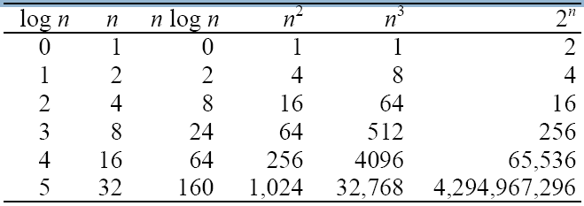
Mathematics Background

Slide 17
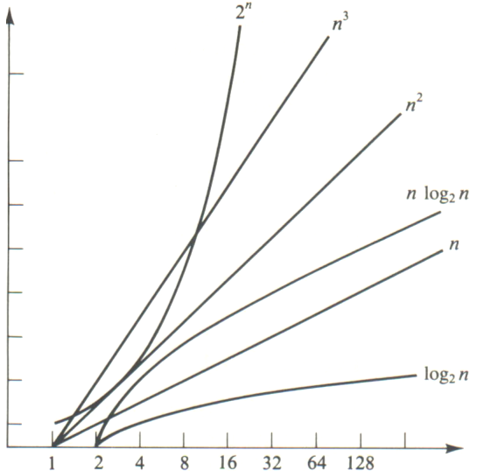
Mathematics Background

Slide 18
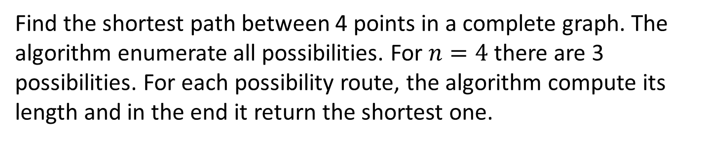
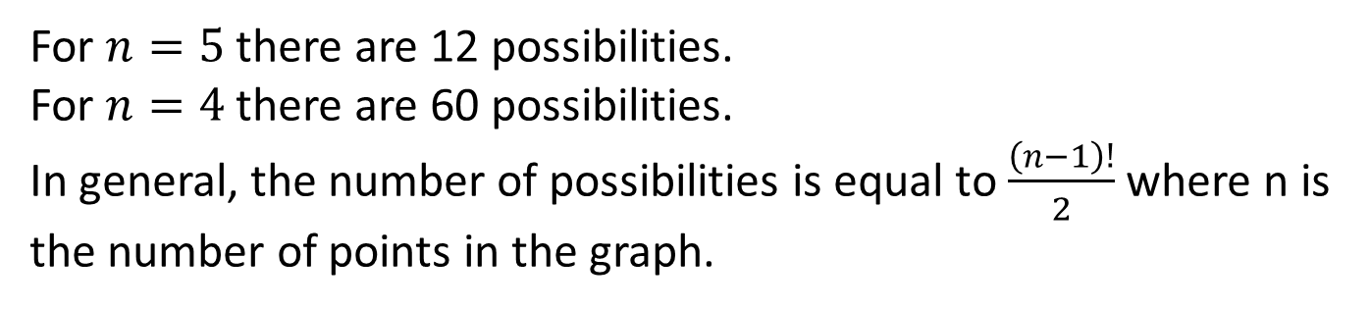
Mathematics Background
Example of an exponential algorithm
6

Slide 19
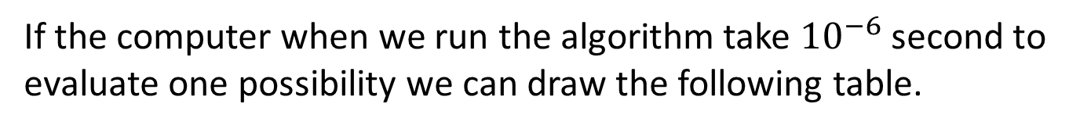
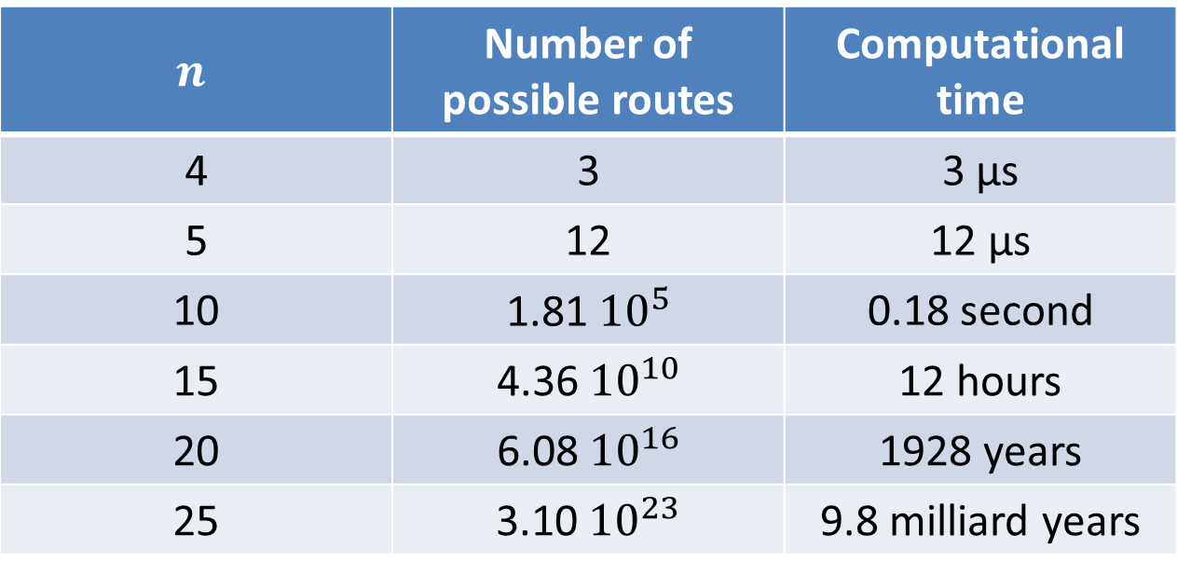
Mathematics Background
Example of an exponential algorithm
 | Number of possible routes | Computational time
4 | 3 | 3 μs
5 | 12 | 12 μs
10 |  | 0.18 second
15 |  | 12 hours
20 |  | 1928 years
25 |  | 9.8 milliard years
Combinatorial explosion !

Slide 20
3. Model
Reading: Textbook (Weiss) 2.2

Slide 21
Model
In order to analyze algorithms in a formal framework, we need a model of computation.
Machine model assumed:
instructions are executed one after another, with no concurrent operations, i.e., not parallel computers
simple instructions such as addition, multiplication, comparison, and assignment.
fixed-size (say, 32-bit) integers
there are no fancy operations, such as matrix inversion or sorting, that clearly cannot be done in one time unit
infinite memory

Slide 22
4. What to Analyze?
Reading: Textbook (Weiss) 2.3

Slide 23
What to Analyze?
Factors affecting the running time:
Computer,
Compiler,
Algorithm used, and
Input to the algorithm
The content of the input affects the running time
The input size is the main consideration (e.g. sorting problem ⇒ the number of items to be sorted)
Obviously beyond the scope of any theoretical model, so, although they are important, we cannot deal with them here.

Slide 24
What to Analyze?
The Maximum Subsequence Sum Problem: Given (possibly negative) integers A₁, A₂, …, A_{N}, find the maximum value of
For convenience, the maximum subsequence sum is zero if all the integers are negative.
Example: input -2, 11, -4, 13, -5, -2
the answer is 20 (A₂ through A₄)

Slide 25
What to Analyze?
Running times of several algorithms for maximum subsequence sum (in seconds)

Slide 26
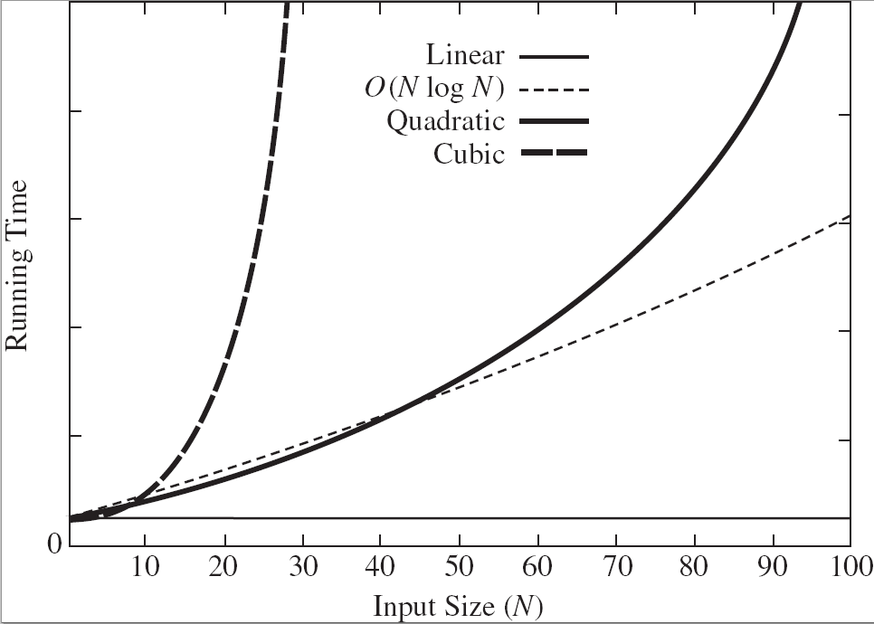
What to Analyze?
Plot (N vs. time) of various algorithms

Slide 27
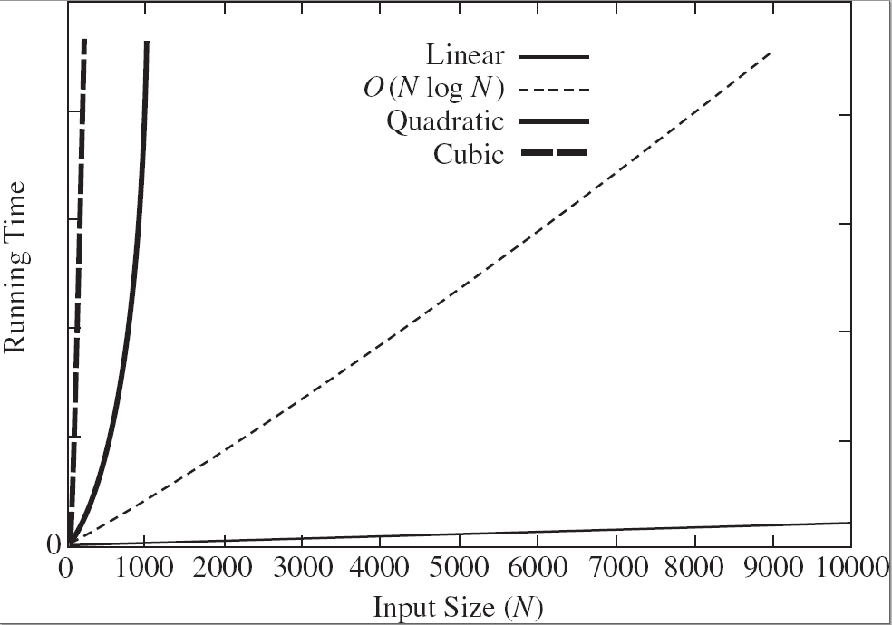
What to Analyze?
Plot (N vs. time) of various algorithms

Slide 28
5. Running Time Calculations
Reading: Textbook (Weiss) 2.4

Slide 29
A Simple Example
Here is a simple program fragment to calculate
int sum (int n)
{
int i, partialSum;
partialSum = 0;
for ( i = 1; i <= n; i++ )
partialSum += i * i * i;
return partialSum;
}
Thus the total cost is 6N + 4 which is equal O(N).
We ignore the costs of calling the function, thus the total is 1 to initialize N
The declarations count for no time.
The cost is 1 to initialize Sum.
The total cost for this line is 1 to initialize i, N+1 for all the tests (i <= N), and N for all the increments, which is 2N + 2.
This line counts for four units per time executed and is executed N times, for a total of 4N units.
We ignore the costs of returning.

Slide 30
General Rules
Ways to estimate the running time
Rule 1 the for loop: The running time of a for loop is at most [the running time of the statements inside the for loop (including tests)] x [the number of iterations].
For example:
for ( i = 1; i <= n ; i++ )
k++
Total cost is 1 + N + 1 + N + N * 1 = 3N + 2, which has O(N).

Slide 31
General Rules
Rule 2 Nested for loops: The total running time of a statement inside a group of nested loops is the running time of the statement multiplied by the product of the sizes of all the for loops.
For example:
for ( i = 0; i < n; i++ )
for ( j = 0; j < n; j++ )
k++
Total cost is 1 + (N+1) + N + N * (1 + (N+1) + N + N * 1) = 3N² + 4N + 2, which has O(N²).

Slide 32
General Rules
The following program fragment is O(N²).
sum = 0
for ( j = 0; j < n; j++ )
for ( k = 0; k < j; k++ )
sum++;
The following program fragment is O(N ³).
sum = 0
for ( j = 0; j < n; j++ )
for ( k = 0; k < n * n; k++ )
sum++;

Slide 33
General Rules
Rule 3 Consecutive Statements: These just add.
For example,
for (i = 0; i < n; i++)
a[ i ] = 0;
for (i = 0; i < n; i++)
for (j = 0; j < n; j++)
a[ i ] += a[ j ] + i + j;
The program fragment, which has O(N) work followed by O(N²) work, is also O(N²).

Slide 34
General Rules
Rule 4 Condition Statement: For the fragment
if ( condition )
S1
else
S2
the running time of a if/else statement is never more the running time of the test plus the larger of the running times of S1 and S2.

Slide 35
Solutions for the Maximum Subsequence Sum Problem
Algorithm 1: Exhaustively tries all possibilities
int maxSubSum1( const vector<int> & a )
{
int maxSum = 0;
for( int i = 0; i < a.size( ); i++ )
for( int j = i; j < a.size( ); j++ )
{
int thisSum = 0;
for( int k = i; k <= j; k++ )
thisSum += a[ k ];
if( thisSum > maxSum )
maxSum = thisSum;
}
return maxSum;
}
Running Time: O(N³)

Slide 36
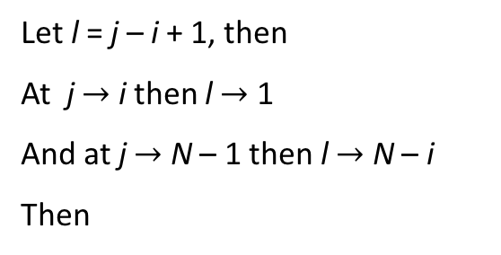
Solutions for the Maximum Subsequence Sum Problem
For algorithm 1, the running time is O(N³).
Proof
Let l = j – i + 1, then
At j $→$ i then l $→$ 1
And at j $→$ N – 1 then l $→$ N – i
Then

Slide 37
Solutions for the Maximum Subsequence Sum Problem
Algorithm 2: Eliminate the last for loop in algorithm 1
int maxSubSum2( const vector<int> & a )
{
int maxSum = 0;
for( int i = 0; i < a.size( ); i++ )
{
int thisSum = 0;
for( int j = i; j < a.size( ); j++ )
{
thisSum += a[ j ];
if( thisSum > maxSum )
maxSum = thisSum;
}
}
return maxSum;
}
Running Time: O(N²)

Slide 38
Solutions for the Maximum Subsequence Sum Problem
For algorithm 2, the running time is O(N²).
Proof

Slide 39
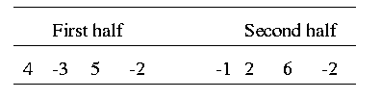
Solutions for the Maximum Subsequence Sum Problem
Algorithm 3: Divide-and-conquer
split the problem into two roughly equal subproblems, which are then solved recursively
patch together the two solutions of the subproblems to arrive at a solution for the whole problem
The maximum subsequence sum can be:
1. Entirely in the left half of the input,
2. Entirely in the right half of the input, or
3. It crosses the middle and is in both halves.

Slide 40
Solutions for the Maximum Subsequence Sum Problem
The first two cases can be solved recursively.
For the last case:
find the largest sum in the first half that includes the last element in the first half,
find the largest sum in the second half that includes the first element in the second half, and
add these two sums together.

Slide 41
Solutions for the Maximum Subsequence Sum Problem
Example: 8 numbers in a sequence,
4 –3 5 –2 -1 2 6 -2
Max subsequence sum for first half = 6 (“4, -3, 5”)
Max subsequence sum for second half = 8 (“2, 6”)
Max subsequence sum for first half ending at the last
element is 4 (“4, -3, 5, -2”)
Max subsequence sum for second half starting
at the first element is 7 (“-1, 2, 6”)
Max subsequence sum spanning the middle is 11
(“4, -3, 5, -2, -1, 2, 6”)
Max subsequence spans the middle
“4, -3, 5, -2, -1, 2, 6”

Slide 42
Solutions for the Maximum Subsequence Sum Problem
Input: A, Left, Right
Output: MaxSubSum of A
MaxSubSum( A, Left, Right)
1. If Left == Right return A[Left]
2. Else
3. Find MaxSubSum( A, Left, (Left + Right) / 2)
4. Find MaxSubSum( A, (Left + Right) / 2 + 1, Right)
5. Find MaxSubSum that contains both A[(Left + Right)/2]
and A[(Left + Right) / 2 + 1]
6. Return the maximum for the three sequences found
O(1)
T(N/2)
T(N/2)
O(N)
O(1)

Slide 43
Solutions for the Maximum Subsequence Sum Problem
Algorithm 3 “divide-and-conquer” strategy
int maxSumRec( const vector<int> & a, int left, int right )
{
if( left == right ) // Base case
if( a[ left ] > 0 )
return a[ left ];
else return 0;
int center = ( left + right ) / 2;
int maxLeftSum = maxSumRec( a, left, center );
int maxRightSum = maxSumRec( a, center + 1, right );
int maxLeftBorderSum = 0, leftBorderSum = 0;
for( int i = center; i >= left; i-- )
{
leftBorderSum += a[ i ];
if( leftBorderSum > maxLeftBorderSum )
maxLeftBorderSum = leftBorderSum;
}
int maxRightBorderSum = 0, rightBorderSum = 0;
for( int j = center + 1; j <= right; j++ )
{
rightBorderSum += a[ j ];
if( rightBorderSum > maxRightBorderSum )
maxRightBorderSum = rightBorderSum;
}
return max3( maxLeftSum, maxRightSum, maxLeftBorderSum + maxRightBorderSum );
}
Running Time: O(N log N)

Slide 44
Solutions for the Maximum Subsequence Sum Problem
int maxSubSum3( const vector<int> & a )
{
return maxSumRec( a, 0, a.size( ) - 1 );
}
int max3( int a, int b, int c )
{
return a > b ? a > c ? a : c : b > c ? b : c;
}

Slide 45
Solutions for the Maximum Subsequence Sum Problem
For algorithm 3, the running time is O(N log N).
Proof
Recurrence equation
2 T(N/2): two subproblems, each of size N/2
N: for “patching” two solutions to find solution to whole problem

Slide 46
Solutions for the Maximum Subsequence Sum Problem
Solving the recurrence:
With k = log N (i.e. 2^{k} = N), we have
Thus, the running time is O(N log N)

Slide 47
Solutions for the Maximum Subsequence Sum Problem
Algorithm 4:
int maxSubSum4( const vector<int> & a )
{
int maxSum = 0, thisSum = 0;
for( int j = 0; j < a.size( ); j++ )
{
thisSum += a[ j ];
if( thisSum > maxSum )
maxSum = thisSum;
else if( thisSum < 0 )
thisSum = 0;
}
return maxSum;
}
Running Time: O(N)

Slide 48
Solutions for the Maximum Subsequence Sum Problem
For algorithm 4, the running time is O(N).
Proof

Slide 49
Solutions for the Maximum Subsequence Sum Problem
An algorithm is O(log N) if it takes constant (O(1)) time to cut the problem size by a fraction (which is usually 0.5).
Anything is halved on each iteration, then you usually get O(log N).
If you have an algorithm which runs in O(log N) time, take it because it will be very fast.

Slide 50
Logarithms in the Running Time
Binary Search: Given an integer X and integers A₀, A₁, …, A_{N-1}, which are presorted and already in memory, find i such that A_{i} = X, or return i = -1 if X is not in the input.
Binary search algorithm:
Compare the search element with the middle element of the array
If not equal, then apply binary search to half of the array (if not empty) where the search element would be.

Slide 51
Logarithms in the Running Time
template <typename Comparable>
int binarySearch( const vector<Comparable> & a,
const Comparable & x )
{
int low = 0, high = a.size( ) - 1;
while( low <= high )
{
int mid = ( low + high ) / 2;
if( a[ mid ] < x )
low = mid + 1;
else if( a[ mid ] > x )
high = mid - 1;
else
return mid; // Found
}
return NOT_FOUND; // NOT_FOUND is defined as -1
}
Running Time: O(log N)

Slide 52
Logarithms in the Running Time
For Binary search algorithm, the running time is O(log N).
Proof
Recurrence equation
Solving the recurrence:
With k = log N (i.e. 2^{k} = N), we have
Thus, the running time is O(log N).

Slide 53
Logarithms in the Running Time
Exponentiation: The following algorithm for computing X^{N} where X and N are two positive integers.

Slide 54
Logarithms in the Running Time
long pow( long x, int n )
{
if( n == 0 )
return 1;
if( n == 1 )
return x;
if( isEven( n ) )
return pow( x * x, n / 2 );
else
return pow( x * x, n / 2 ) * x;
}
Running Time: O(log N)

Slide 55
Logarithms in the Running Time
For Exponentiation algorithm, the running time is O(log N).
Proof
Exercise

Slide 56
Worst Case, Best Case, and Average Case
When sorting a list of numbers in ascending order; we might have one of the following cases:
Worst Case: The list is sorted in descending order, then maximum number of swaps is performed.
Average Case: The list is unsorted, then average number of swaps is performed.
Best Case: The list is sorted in ascending order, then minimum number of swaps is performed.

